Slide 1
Outlier Injection in K-Means Clustering
Poison Cluster Team
Regina Izsa, Máté Balogh, Anass El Aqli, Levente Malecz, Henrik Berényi
Budapest, 2025.05.06

Slide 2
Project Description
Data poisoning attacks: inserting false data to manipulate clustering results
Challenges in detecting poisoned data
K-Means Clustering
Partition-based clustering
Sensitive to outliers and initialization
Iris dataset
Well-known dataset for classification/clustering
Three natural clusters (species)

Slide 3
Attack Strategies
Data Poisoning Attacks
Injecting false data to alter cluster formation
Creating adversarial examples
Outlier Injection:
Informed Injection (Synthetic data)
Inserting data on cluster borders
Mimicry-based attack
Hyperparameter poisoning in semi-supervised model
Classification for comparison
Randomized data
Random noise
Label shuffling
Injecting subtle data

Slide 4
Contributions
Regina
Synthetic noise based outlier injection between two clusters to blur borders
Máté
Mimicry-based attack to conceal outliers, hyperparameter poisoning
Anass
Including classification attacks for comparison
Levente
Random noise based outlier injection methods
Henrik
Clustering and evaluation of random noise outlier injection methods

Slide 5
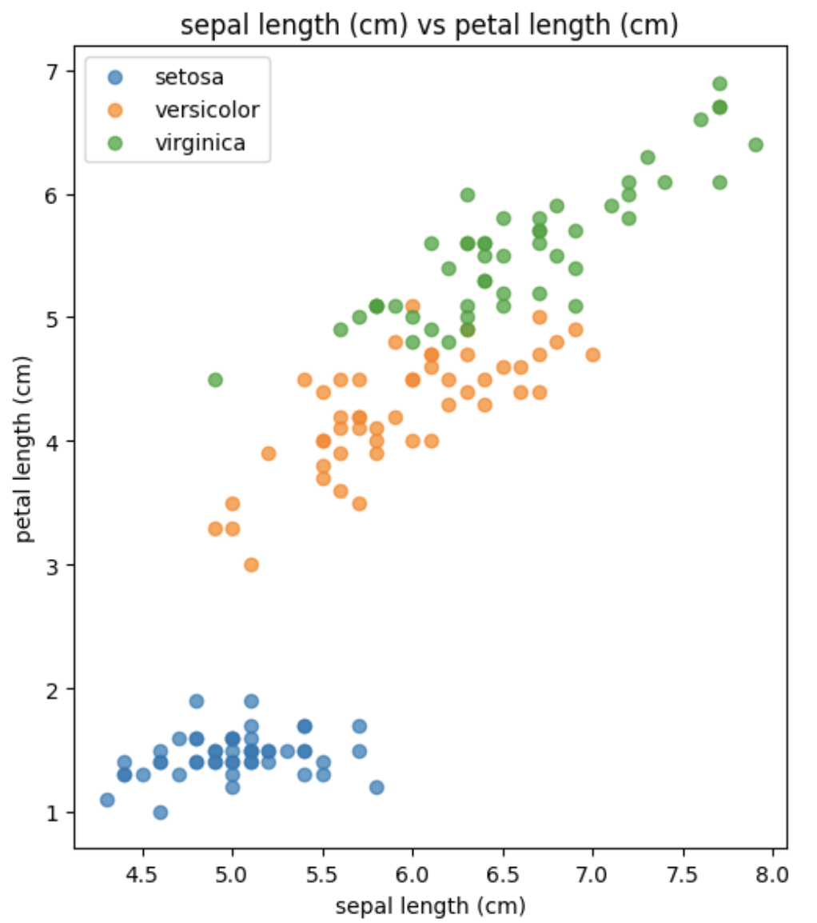
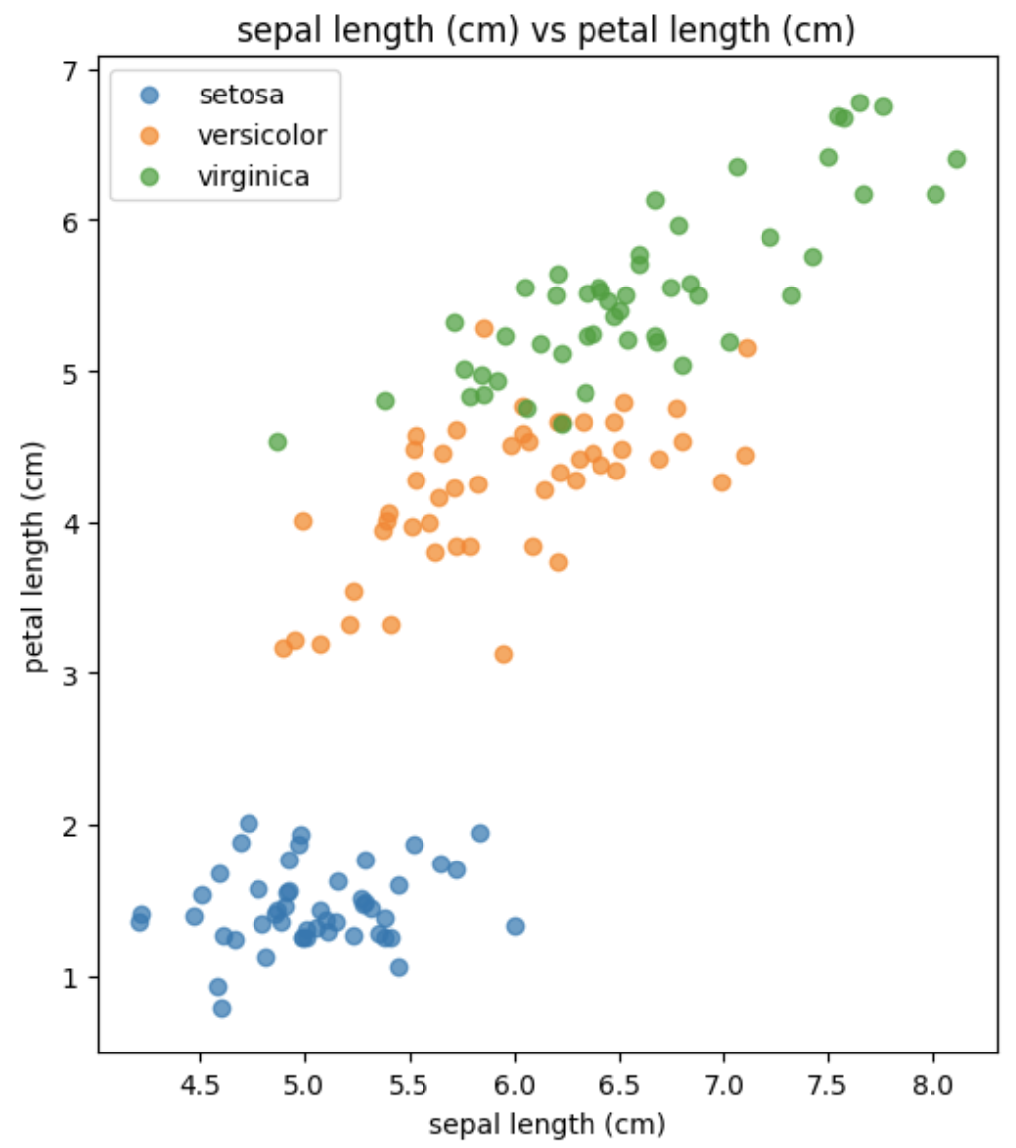
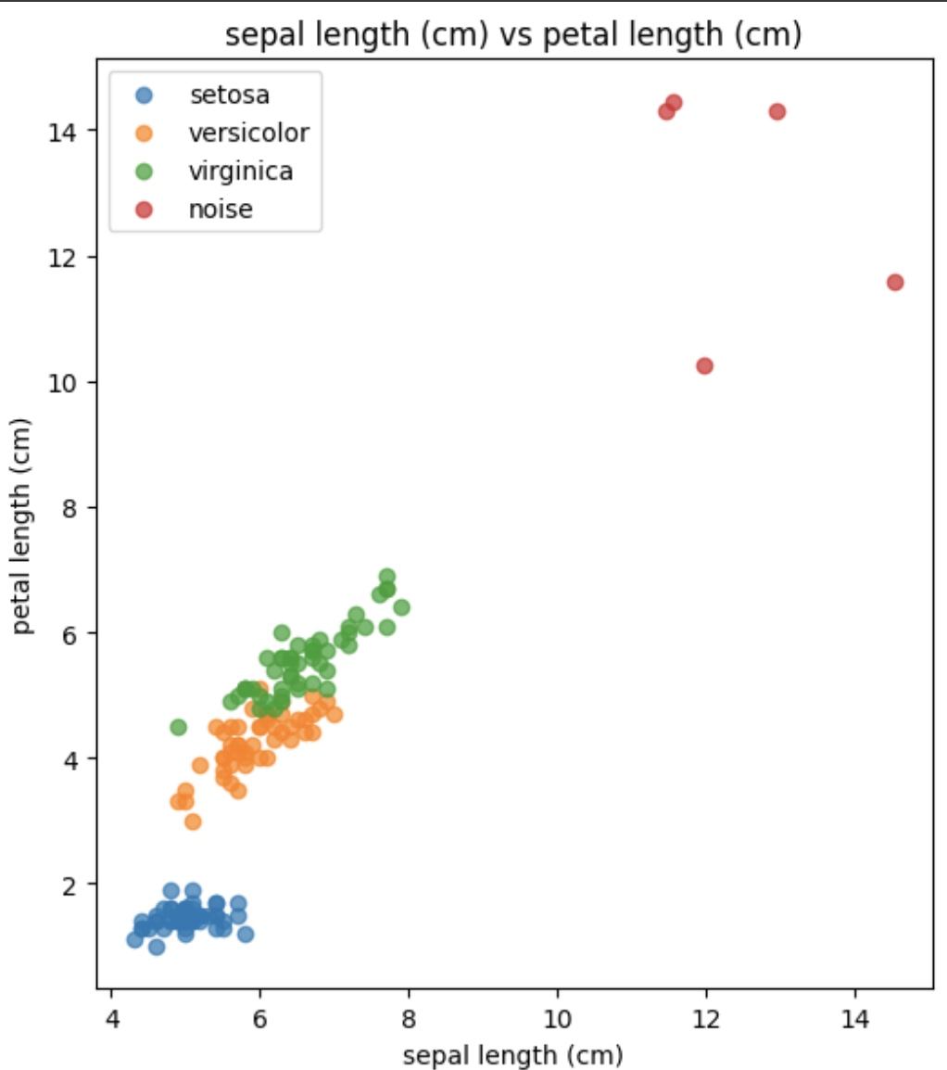
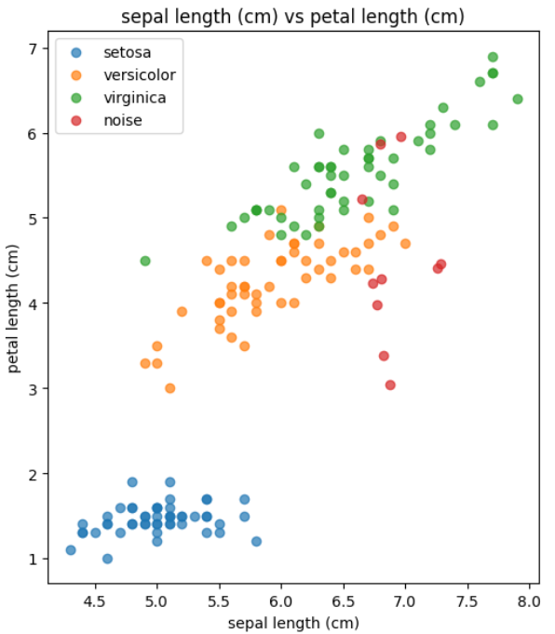
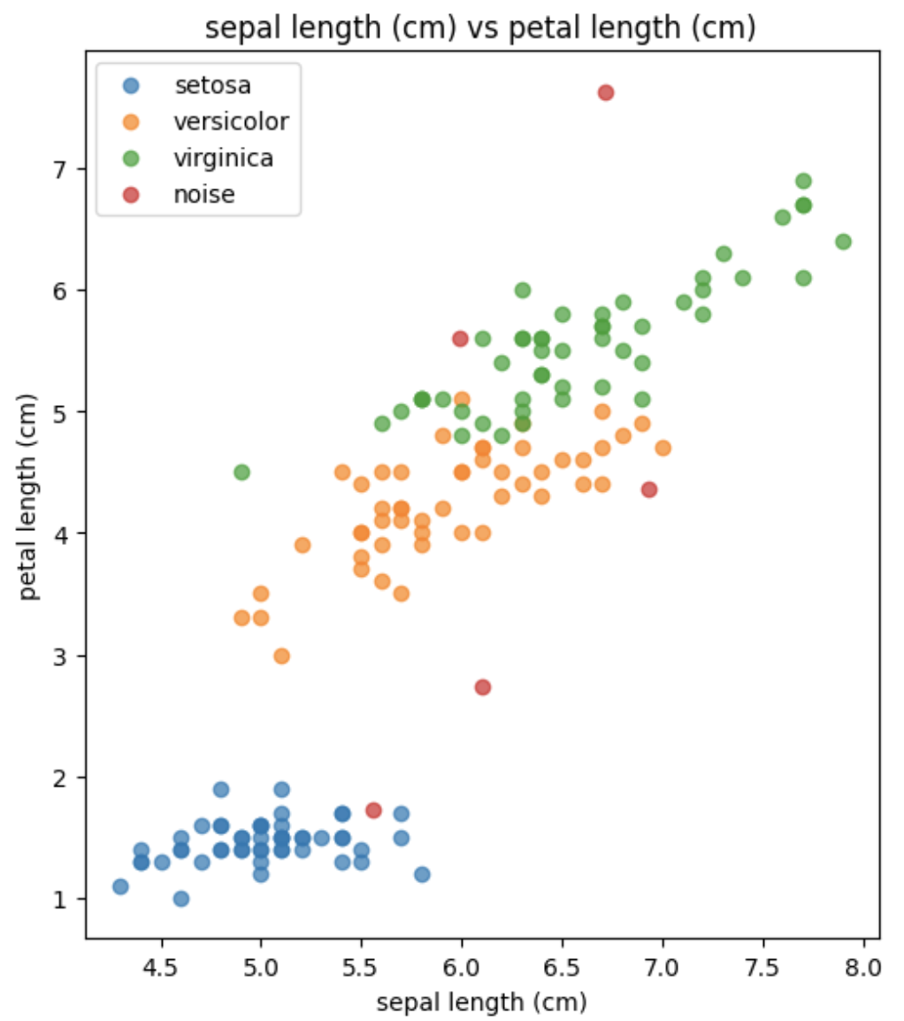
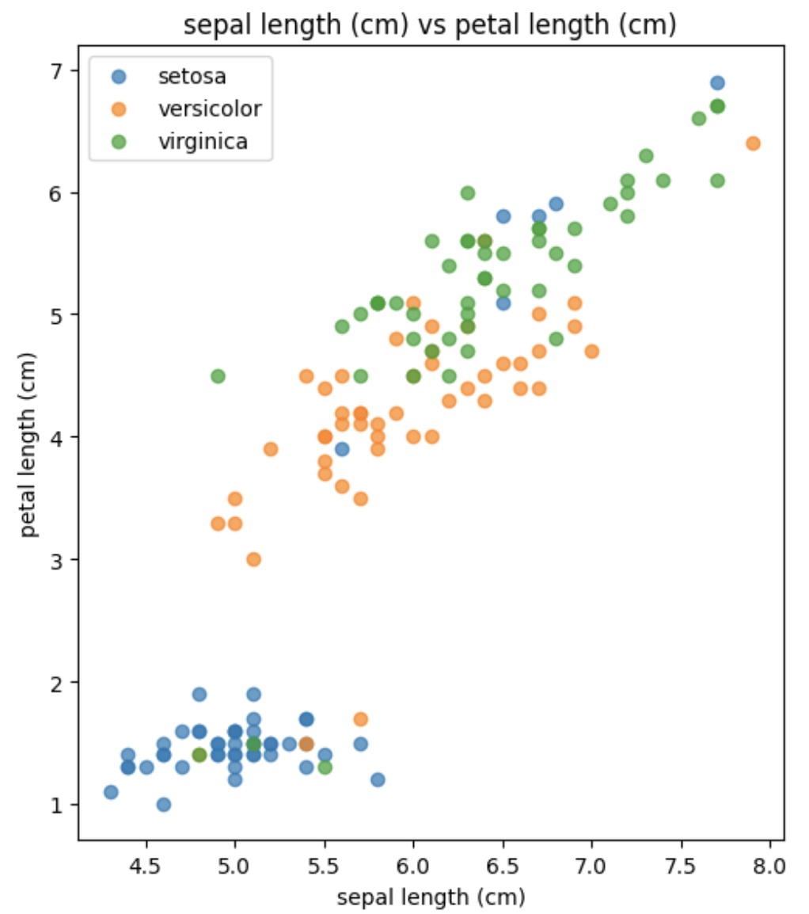
Randomized Injection
Gaussian Noise
Uniform Outliers
Subtle Outliers
Shuffled Labels
Autoencoder Outliers

Slide 6
Randomized Injection
 | Noisy | Uniform | Subtle | Shuffled | Model
Pros | Makes clusters fuzzy Reduces cluster boundaries | Creates extreme values | Hard to detect | Greatly disturbs the data | Based on training goals can be hard to detect or it can create extreme values
Cons | Varied success due to randomization | Easy to detect | Needs a lot of injected data to cause mass disruption | Has no effect in purely unsupervised settings | The model needs finetuning on the dataset

Slide 7
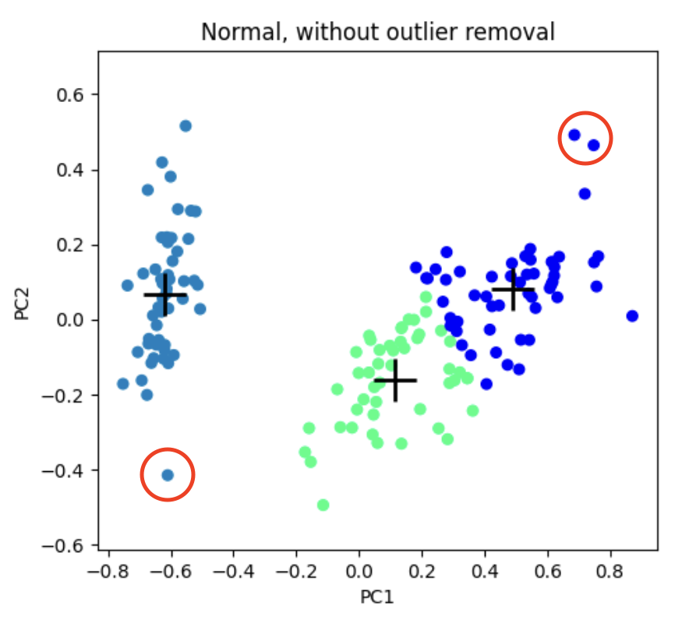
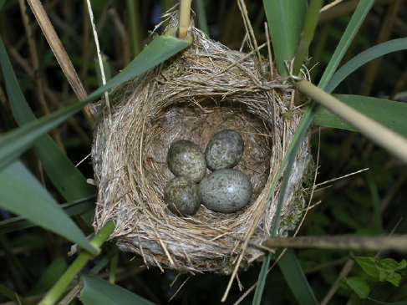
Informed Injection — Mimicry
Image source: The past, present and future of 'cuckoos versus reed warblers'

Slide 8
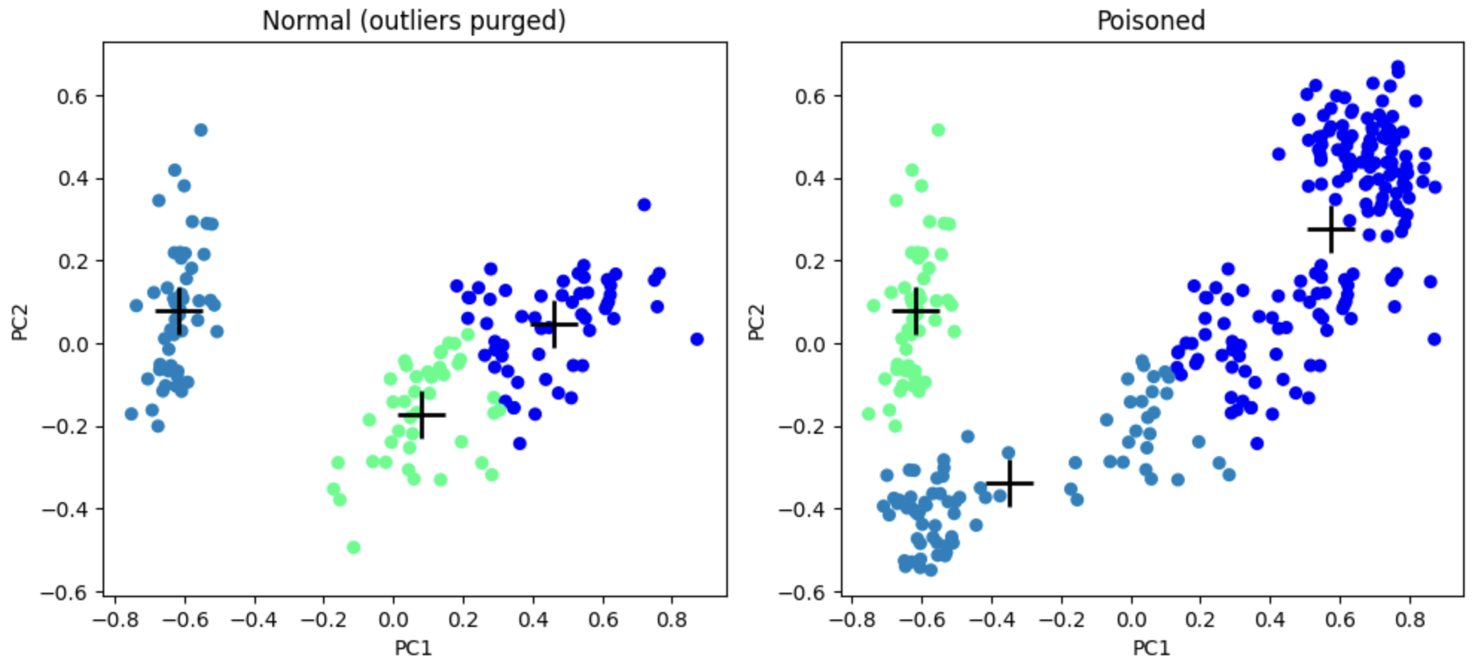
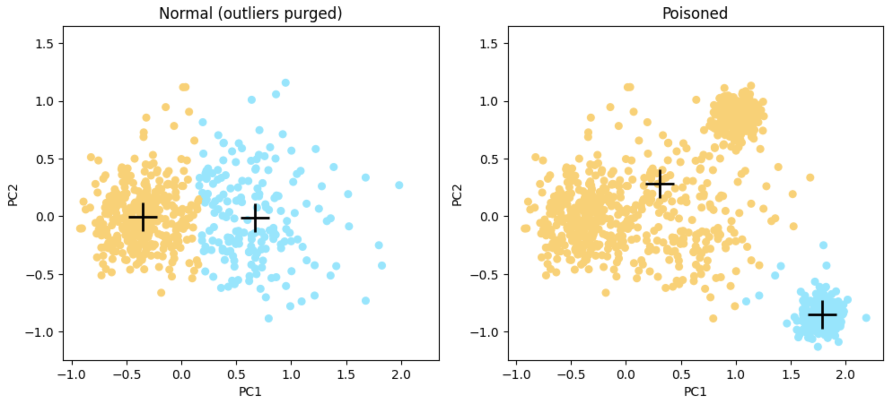
Informed Injection — Mimicry

Slide 9
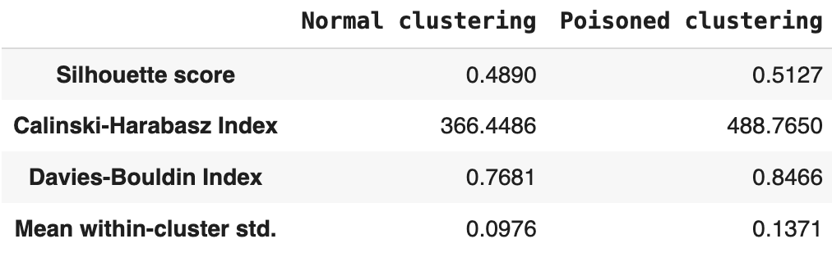
Informed Injection — Mimicry
Pros | Despite shifting the centroids along with the possibility to change cluster boundaries, it does not significantly change performance metrics, at least not for the worse. Some of the scores may even generate false confidence.
Cons | Relies on outliers in the dataset.
Notebook (Iris) Notebook (Breast cancer)

Slide 10
Beyond Mimicry: Contextual Reversal

Slide 11
Informed Injection — Hyperparameter Poisoning
Poisoning a hyperparameter of semi-supervised KMeans:
Given small labeled sample data
Perform label flipping on the sample data
Calculate centroids (average position) for each class, assign the label
KMeans is initialized with the centroids
Clustering is performed
Centroids and label information traverse while fitting the data
Classification is made by the centroid’s label information for each formulated cluster
Expectations: Misclassification. Clustering result may remain unchanged.

Slide 12
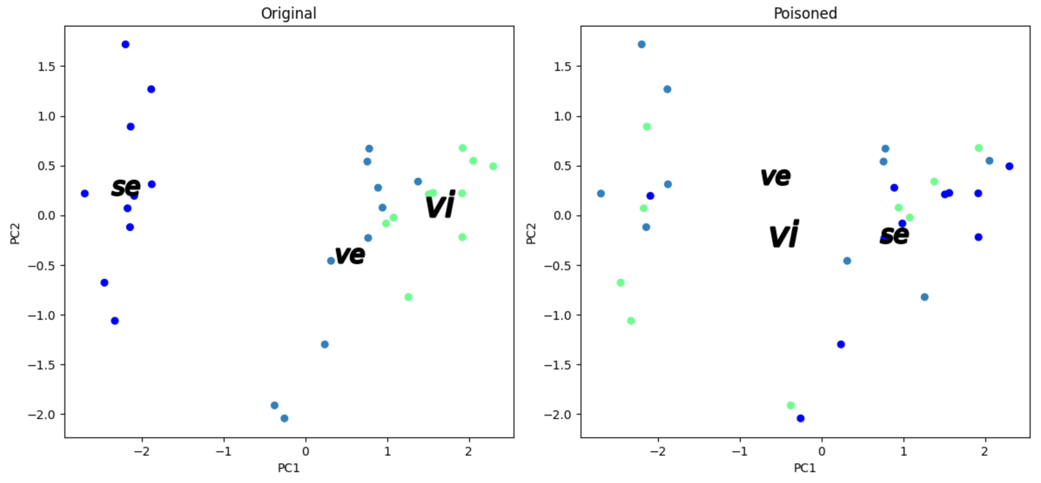
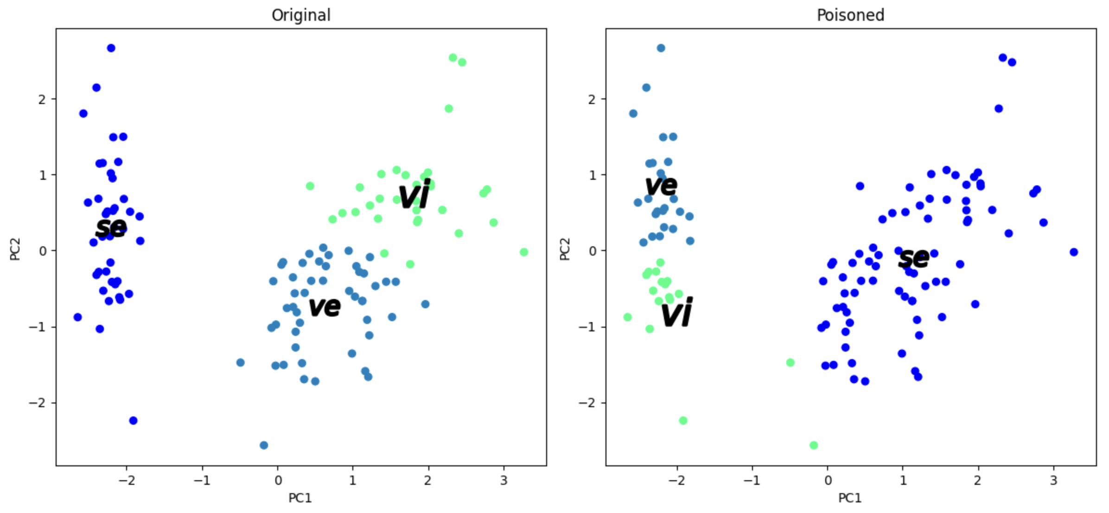
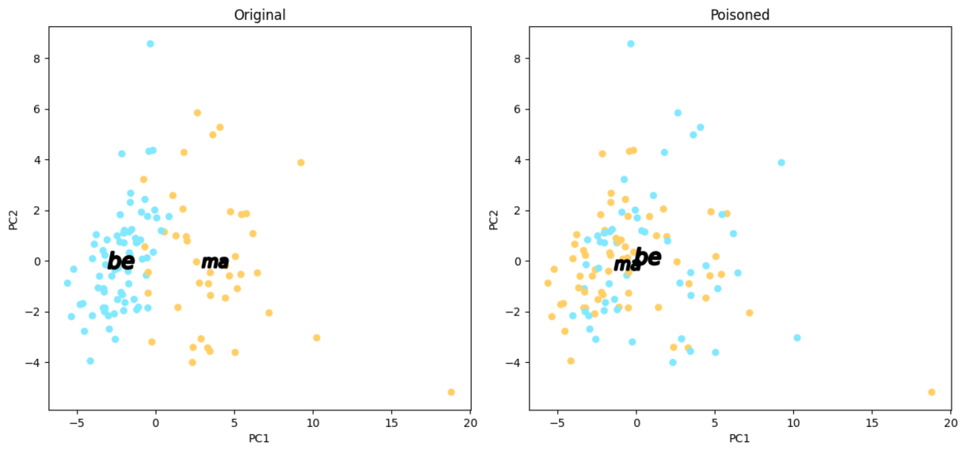
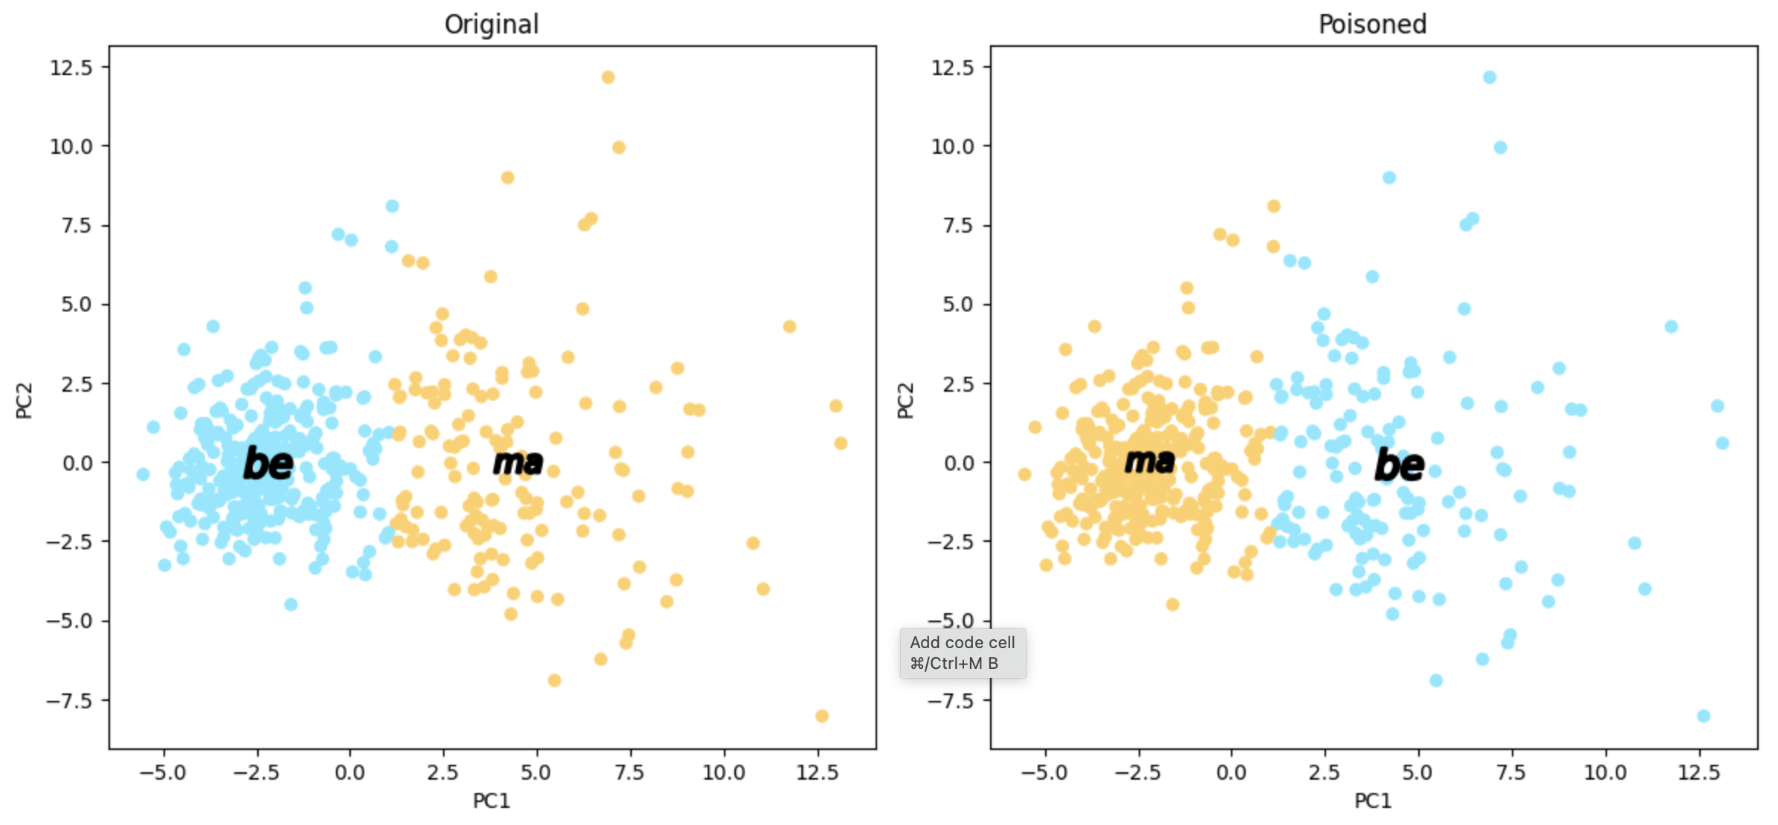
Informed Injection — Hyperparameter Poisoning

Slide 13
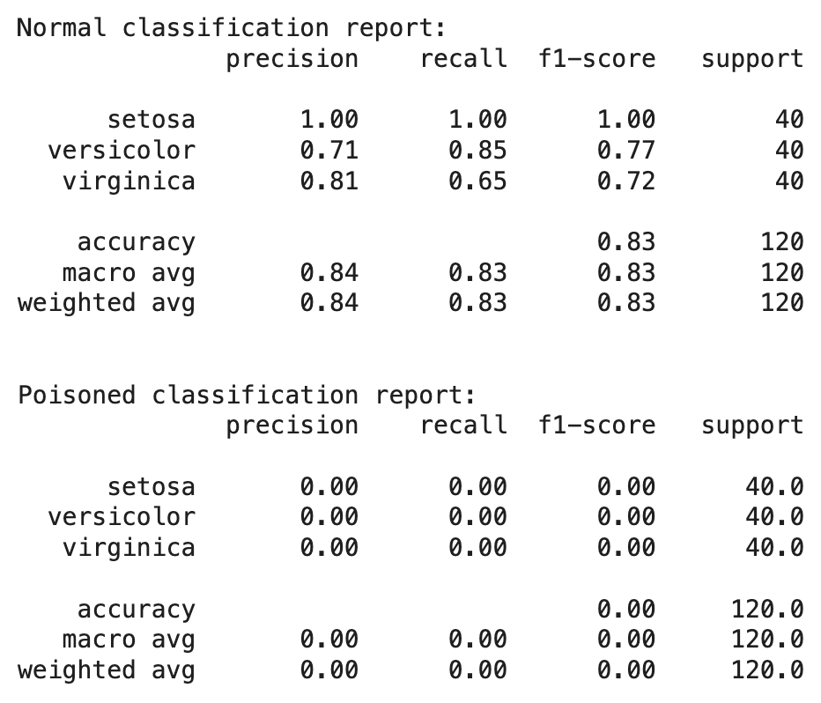
Informed Injection — Hyperparameter Poisoning
Pros | Only the sample data is needed to be poisoned. It makes entire cluster-wide mistakes. Centroids and cluster boundaries may remain unchanged.
Cons | The label flipping ratio needs to be large enough, around 80% on average for the Iris dataset. Centroids and cluster boundaries may remain unchanged.
Notebook (Iris) Notebook (Breast cancer)

Slide 14
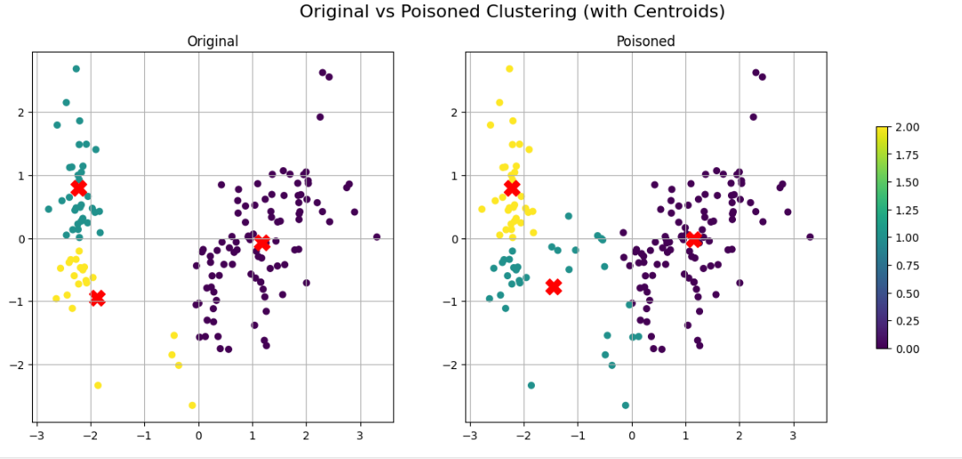
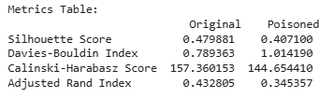
Creating synthetic noise around the centroids
It creates fake samples around the center of the real data.
It adds more disturbance to the important features (petal measurements).
It adds little disturbance to the less important features (sepal measurements).
The goal is to confuse clustering without making it look completely unrealistic.

Slide 15
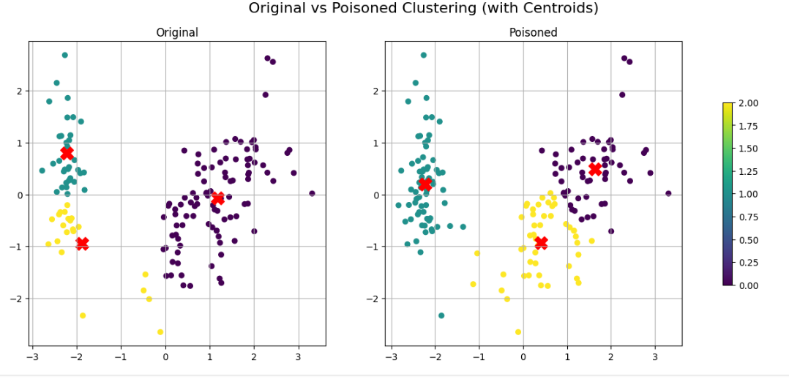
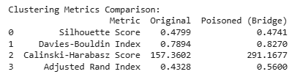
Creating synthetic noise between two culsters to blur the borders
It creates fake samples between two real clusters.
It blurs the boundary separating the original clusters.
It makes clustering harder without adding obvious outliers.
The goal is to mislead the algorithm into merging clusters.

Slide 16
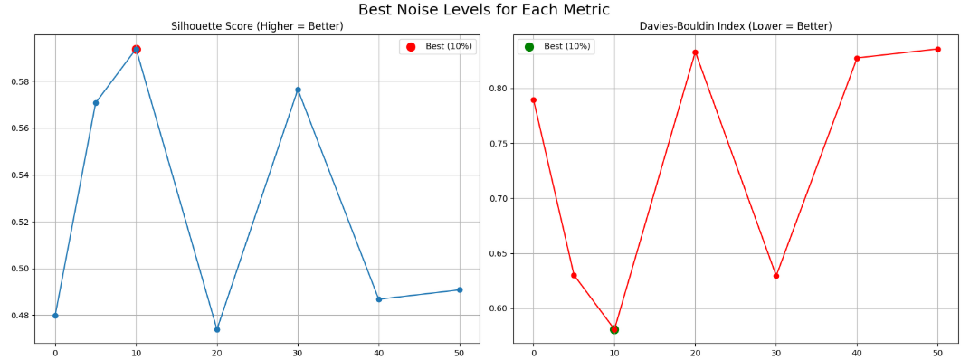
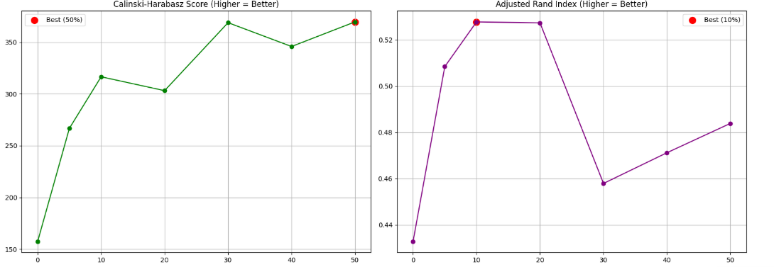

Slide 17
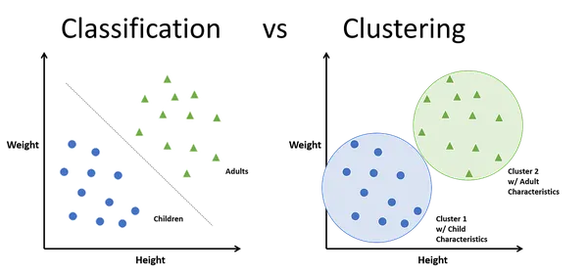
Classification VS Clustering
Classification
🔹 Supervised learning (uses labeled data)
🔹 Predicts categories (e.g., spam/not spam)
🔹 Measures: Accuracy, Precision, Recall
🔹 Example: SVM, Decision Trees
🔹 Attack Goal: Cause misclassification
Clustering
🔹 Unsupervised learning (no labels)
🔹 Groups similar data (e.g., customer segments)
🔹 Measures: Silhouette Score, Inertia
🔹 Example: K-Means, DBSCAN
🔹 Attack Goal: Distort group structure

Slide 18
Thank you for your attention!

